Slide 1
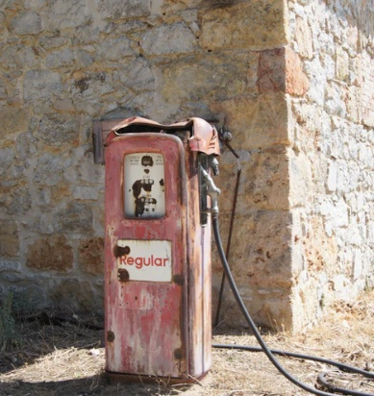
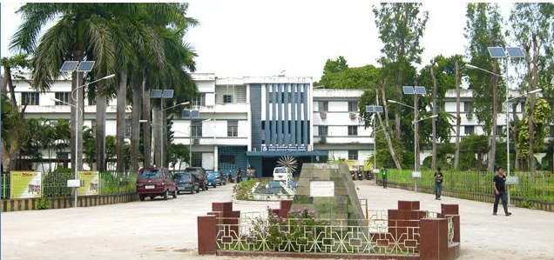
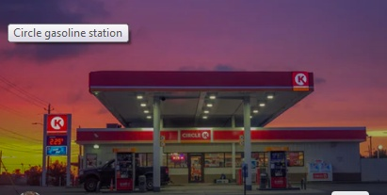
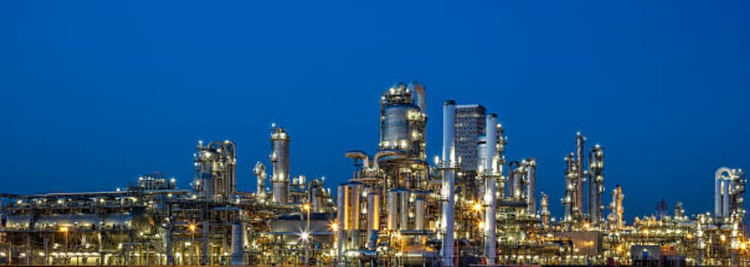
Petroleum Chemistry and Engineering
Unleaded petrol
Engineering Chemistry: CYC 01
(Dr. J. Chakravorty, Prof. S. C. Moi and Dr. U. Adhikari)
Department of Chemistry
National Institute of Technology Durgapur
M. G. Avenue, Durgapur WB, India; www: nitdgp.ac.in

Slide 2

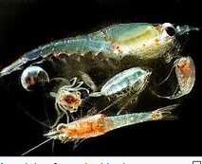
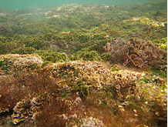
Chapter-3: Petroleum Chemistry and Engineering
Syllabus: Origin of petroleum/crude oil or fossil fuel, Purification of crude oil and removal of undesirable materials, fractional distillation of crude oil, name of different fractions with approx. number of carbon contain in hydrocarbons, boiling point range of each fraction, their uses in our daily life, Knocking, antiknock compounds, composition of petrol and diesel, octane number and cetane number, Cracking of hydrocarbon, thermal and catalytic cracking, Bio-diesel.
3 Lectures
Regarding the origin of fossil fuel have different hypothesis or concept given by geologist.
The most accepted and reliable theory is as follows
Petroleum is a fossil fuel, originated from ancient time fossilised organic materials like different small and giant animals, zooplankton, algae etc. Due to natural calamity all these living bodies were buried under earth crust, for a long time under pressure, temperature and natural available catalyst in absence of oxygen converted into hydrocarbon.
Fossil
Zooplankton
Algae

Slide 3
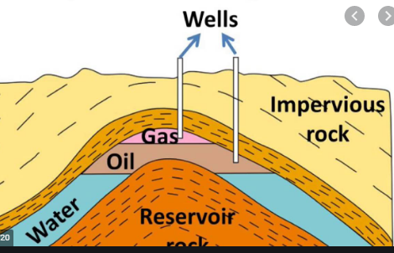
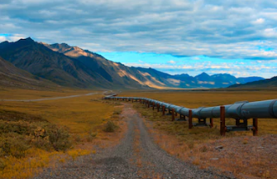
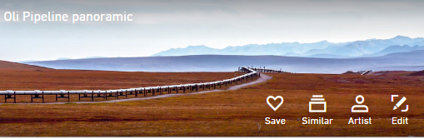
Extraction of crude oil from wells (Science and Engineering):
Hot air and water are passed through pipe lines under pressure into the deep layer, where crude oil is reserved at the depth of earth’s crust. Under pressure mainly hydrocarbons remain as solid, which is difficult to fetch from under ground. Naturally In presence of hot air and water hydrocarbons are form emulsion or become gas. Consequently less viscous and more gaseous materials are easily extracted with high suction pump through pipelines.
Hot air and water
Removal of solid gangue materials from crude oil (Science and Technology)
Crude oil extracted from the earth’s crust mainly contains silica, mica, insoluble material, water, hydrocarbon and
natural gas. Silica, mica and insoluble materials are separated by keeping the mixture in tank or reservoir for a
certain period and heavy insoluble material are settle down under gravity in natural process. Insoluble material
settle at the bottom of the tanks and emulsion of water and hydrocarbon mixture remain in upper layer, which is
separated from undesirable materials.

Slide 4
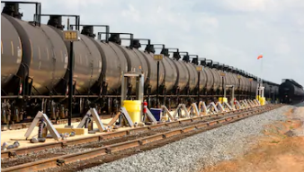
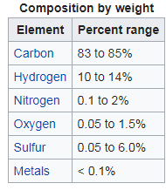
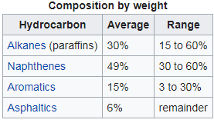
( Application of Electrical Engineering and Science) (Cottrell’s process)
The emulsion of crude oil is passed through highly voltage (10,000-15,000 Volt) with special designed metal plates with
positive and negatively charged. Negative charged plate emits electrons and small water droplets received easily and
attracted by the positively charged plated. As a result small droplets become bigger water drop and separated from the
emulsion.
(Application of knowledge of Chemistry)
Crude oil mainly contains aliphatic, alicyclic, aromatic and nitrogen and sulfur containing compounds. To obtain clean and
safe different components of hydrocarbons, removal of sulfur is must and is done by passing hydrocarbon mixture through
catalytic bed containing CuO. Sulfur containing compounds react with Cu₂O and form solid black Cu₂S, which is removed by filtration.
(Application of Civil Engineering)
Impurities free crude oil is transported to oil refinery through pipe lines or through railway transport. I think you have
experience about the obnoxious smell of crude, when stopped the oil tanker of railway wagon / goods train in rail station.
Sulfur containing hydrocarbons are pollutants and hazardous.
Composition of crude oil as % of different elements and different components

Slide 5
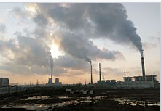
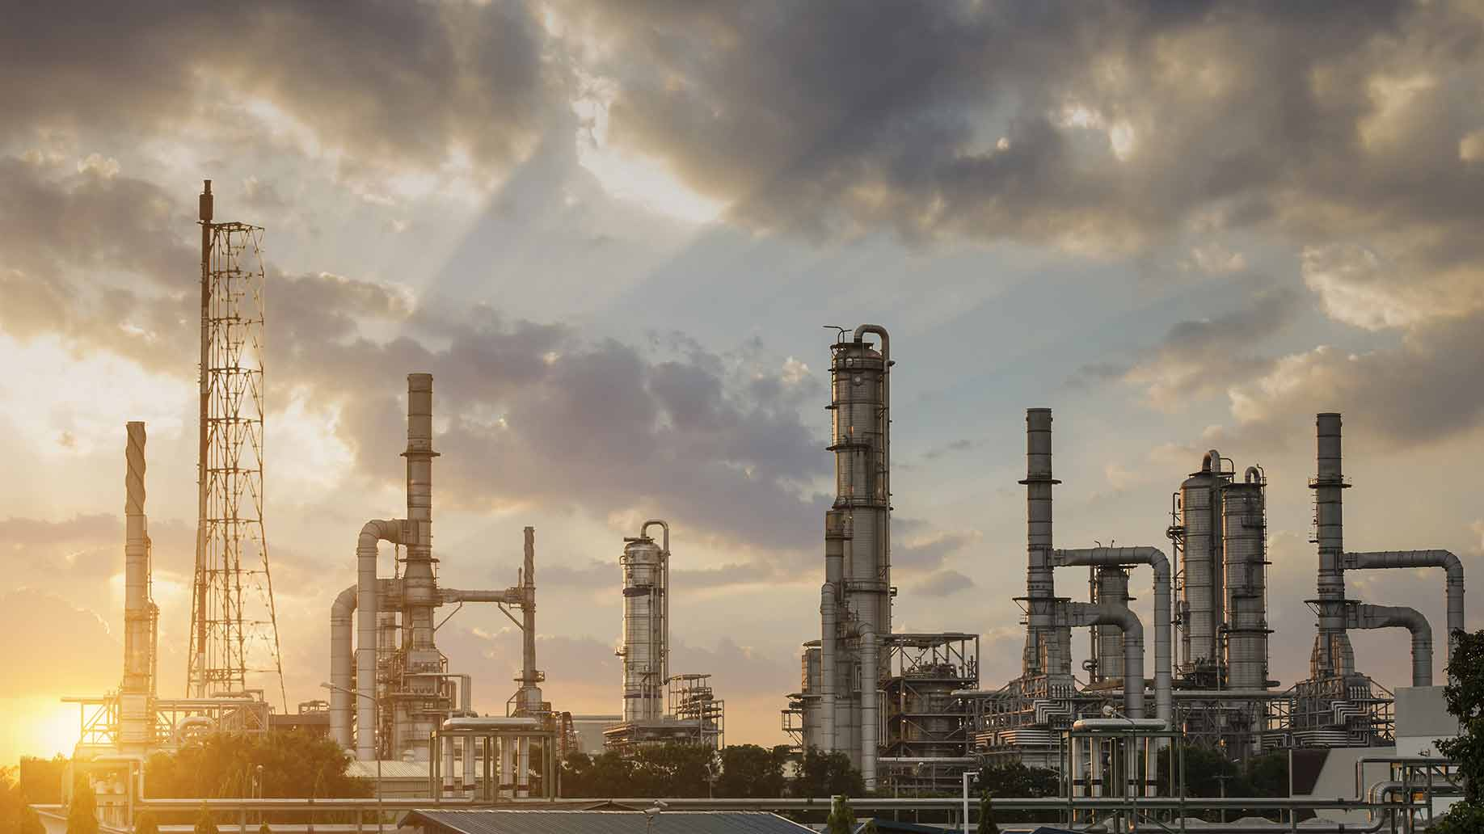
Petroleum: a thick and viscous with obnoxious smell, flammable, yellow-to-black mixture of solid, liquid, and gaseous hydrocarbons which is collected from Earths crust.
Crude oil: Mixture of HCs (hydrocarbons) and silica, mica, mud, water, nitrogen and sulfur containing hydrocarbons etc. It is raw material for oil refinery and also used in thermal power plant to run after lit up unless the power plant is in position of power generation. Thermal power plants run with crude oil near about six hrs before power generation, It’s like baby food.
Natural gas: Gaseous mixture of naturally occurring with C₁-C₄ carbon containing hydrocarbons.
Thermal power plant exhorts
highly dense black smoke due
to presence of aromatic and
unsaturated hydrocarbon’s
incomplete combustion.

Slide 6
Composition of Crude Oil

Slide 7
Fractional distillation is a physical method of separation of a mixture of different components having difference of B.P at least 10-15 ºC of each components based on temperature gradient in a long tower. The mixture of crude oil is heated in electric furnace at around 400-450 º C and the vapour of the mixture is passed through fractionating column in oil refinery with arrangement of collection of different fractions according to our desirability. The different fractions, which we obtain are as follows. Their composition, B.P, and uses are shown below.
Name of fraction | Boiling point range in (ºC) | Composition of hydrocarbon | Uses
Uncondensed gas | Below 30 | C₁- C₄ | As domestic and Industrial fuel named as LPG
Petroleum ether | 30-70 | C₅-C₇ | As motor fuel
Gasoline or Petrol | 40-120 | C₅-C₉ | As motor fuel, solvent and in dry cleaning
Naphtha or solvent sprit | 120-180 | C₉-C₁₀ | As solvent in dry cleaning and starting components of thermal cracking.
Kerosene oil | 180-250 | C₁₀-C₁₆ | As an illuminant, jet engine fuel and for preparation of Laboratory gas
Diesel oil or gas oil | 250-320 | C₁₀-C₁₈ | Diesel engine fuel
Heavy oil | 320-400 | C₁₇-C₃₀ | For getting gasoline by cracking

Slide 8
Heavy oil on further fractional distillation, we obtain the different components are as follows.
Name of fraction | Boiling point range in (ºC) | Composition of hydrocarbon | Uses
Heavy oil gives Lubricating oil |  | C₁₇- C₃₀ | As Lubricant
Petroleum Jelly |  |  | As lubricant and in cosmetics and medicines in ointment
Grease |  |  | As lubricant
Paraffin wax |  |  | In candle, boot polishes, wax paper tarpolin cloth
Residue may be either | Above 400 | C₃₀ and above
(i) Asphalt |  |  | Water-proofing of roofs and road making
(ii) Petroleum coke |  |  | As a fuel in moulding arc light rods.

Slide 9
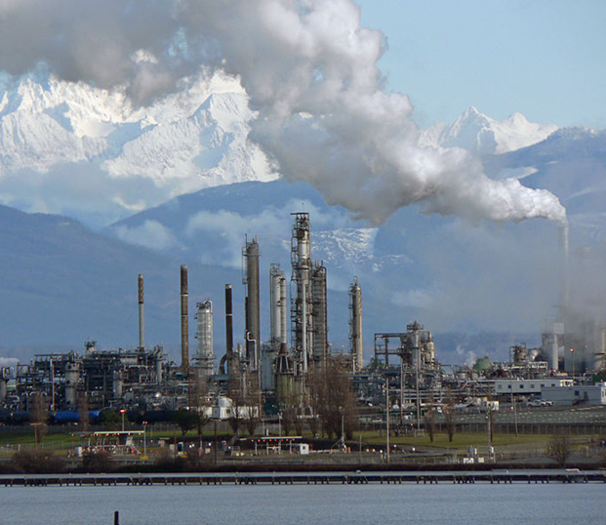
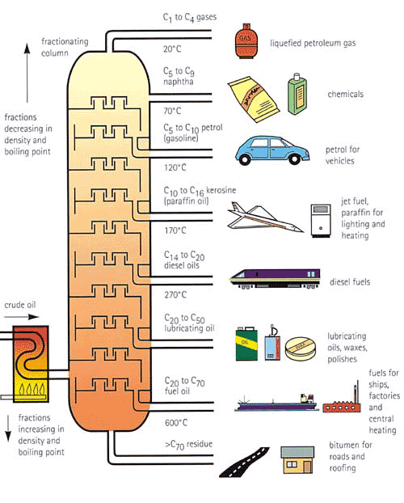
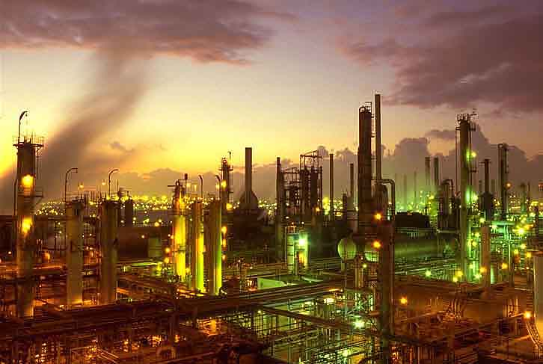
gases
naptha
gasoline
kerosene
diesel
lubricants
fuel oil
residue
Internal design of fraction distillation column with collecting units.

Slide 10
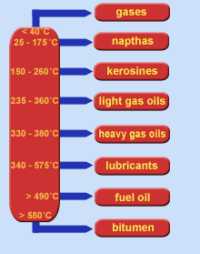
Fractional distillation of crude oil
Oil is extracted from the ground as crude oil. Undesirable materials like; silica, mica,
mud and water etc are removed on spot
of oil wells. This partial viscous liquid is transported to oil refinery.
It is then refined in a distillation tower that is divided into a series of collecting trays at different temperature conditions.
The crude oil is heated at around 400-450 ºC to make all the components into vapour.
The vapour is allowed to diffuse upward the tower to cool and condense at different temperatures (lightest compounds will have lowest boiling temps).
The different components of crude oil can therefore be separated.

Slide 11
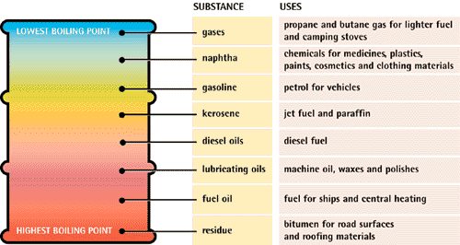
Fractions obtained from crude oil
Fractions that condense in each tray are extracted and used for different purposes.
The smallest (lightest; at top) hydrocarbon molecules are used as gases.
Intermediate hydrocarbon molecules are used in liquid form.
Largest (heaviest; at bottom) hydrocarbon molecules as used as solids (e.g. tar).

Slide 12
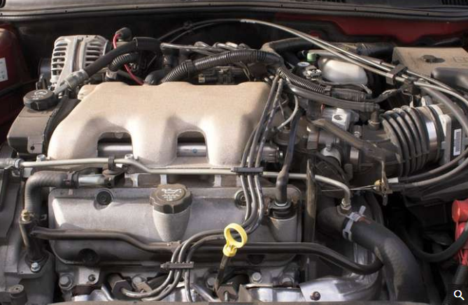
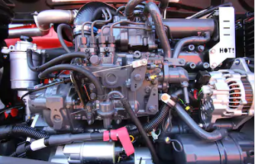
Few Technical and Scientific terms:
(i) Internal combustion engine
(ii) Branch chain and unbranched long chain hydrocarbon
(iii) Stability of carbocation and free radicals
(iv) Calorific value of hydrocarbon
(v) Knocking, Anti-knocking compound
(vi) Unleaded petrol
(vii) Composition of petrol and diesel
(viii) Octane number and cetane number
(viii) Cracking of hydrocarbons
Internal combustion engines are the most broadly applied and widely used power-generating devices currently in existence. Examples include petrol engines, diesel engine, gas turbine engines and rocket propulasion engines.
What is Internal-combustion engine? These are mechanical devices in which the reactants of combustion (oxygen in air oxidizer and petrol or diesel as fuel) and the products of combustion (CO₂ and H₂O as gas) serve as the working gas/fluids of the engine. The gas expands and push the piston within the cylinder and come back to same position after releasing the gas. Such an engine utilise the heat released during the combustion and transform heat energy to mechanical work with repeating the thermodynamical cycle. Useful work generated by an internal-combustion (IC) engine results from the hot gaseous products of combustion acting on piston, turbine blade and nozzle.

Slide 13
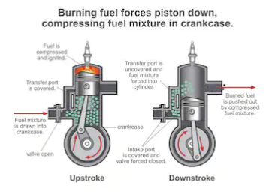
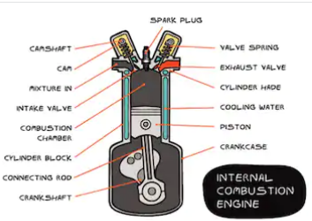
Working steps of IC:
The simple working steps in internal combustion engines(IC) are shown in following figures. A combustible chamber is designed with inlets of fuel and air. An ignition spark plug is placed as igniter, which ignites as we desire. A friction less piston is arranged inside, which could move to outside as the gas expand inside. Other end is joined through shaft with whiles, which moves on the surface.

Slide 14
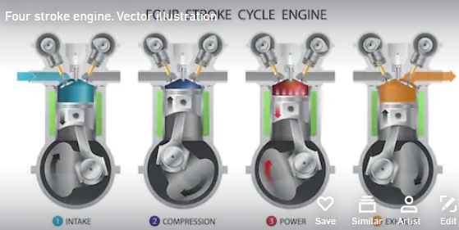
(ii) Branch chain and unbranched long chain hydrocarbon:
In presence of sufficient oxygen, straight chain hydrocarbons burn within short time while branched chain hydrocarbons
Combustion time is longer. (Home work : explain why?)
(iii) Stability of carbocation and free radicals (Home work: write short notes)
Home work:
“In general, calorific values of hydrocarbons is function of molecular weight of saturated hydrocarbons but not always true” Criticize or explain the statement.

Slide 15
(v) Knocking, antiknock compounds and Unleaded petrol:
Due to rapid combustion of hydrocarbons particularly straight chain compounds in Internal combustion engine, the
thermodynamical cycles repeats very fast, as a consequent a pattering sound generates from the engine, which is
technically called as ‘knocking’ of internal combustion engine. During combustion, straight chain hydrocarbons are
fragmented as either primary or secondary free radicals. Their stability is very less, as a result burn rapidly to CO₂ and
H₂O with quick release of large amount of heat. This released heat repeats very fast leads uncontrolled movement of
piston. Naturally to reduce the knocking, free radical quencher, particularly Tetraethyl lead; (C₂H₅)₄Pb (TEL) is used to
increase the life time of free radicals, generated during combustion. At high temperature, TEL decomposed to generates
ethyl free radical, which combines with fragmented free radicals leads to increase the combustion time, consequently
knocking reduced.
CH₃-CH₂-CH₂-CH₂-CH₂-CH₂-CH₂-CH₂-CH₂-CH₃ CH₃-CH₂-CH₂ . ₊ CH₃-CH₂-CH₂-CH₂-CH₂-CH₂-CH.₂ free radical
combined with C₂H₅. Both are 1º primary free radicals (unstable)
CH₃-CH₂-CH₂ -CH₂-CH₃
Pb(C₂H₅)₄ Pb(C₂H₅)₂ + 2 C₂H₅. free radical
Combine
CH₃-CH₂-CH₂ -CH₂-CH₂-CH₂-CH₂-CH₂-CH₃
Stable for a certain time at the time of combustion
Pb + 2C₂H₅.
free radical
It is the subject of chemistry
To avoid the knocking, when TEL is used, another sever problem arises due deposition of lead metal in side chamber of IC.
Next time, when try to start the engine, it takes to more time to kick to remove the solid lead metal from the chamber.
Naturally chemists solve the problem by adding another ingredient 1,2-Dibromoethane to remove the lead metal from the
Chamber. As a consequence, another serious environmental problem arises due to formation of PbBr₂, a dangerous gaseous
Heavy metal compound comes our with the exhaust gases., which have sever health effect. Naturally, TEL and 1,2-Dibromoethane are avoided with petrol., which is known as Unleaded petrol.

Slide 16
Cracking of hydrocarbon:
Cracking is mainly fragmentation of heavy residue (particularly naphtha and other undesirable long chain hydrocarbons
of distillation fractions) either in presence of catalyst or in absence by heating to obtain desirable components is known
as Cracking.
Cracking improves the following quality of Hydrocarbons:
(i) it increases the amount of gasoline and other economically important fractions
(ii) it increases branching in chains, an important factor for petrol
(iii) it produces alkenes, an important feedstock for chemicals
Cracking of hydrocarbons are done by mainly two methods:
Thermal cracking ( at high temp. 475-530 ºC and pressure (100 kg/cm²)
Catalytic cracking (Aluminium silicate Al₂(SiO₃)₃ or alumina Al₂O₃)
Thermal cracking: done again two different process.
(a)Liquid phase thermal cracking( the heavy oils are subjected to high temperature and pressure, when bigger HCs
molecules breakdown to gives small molecules. 100 kg/cm². The cracked products are separated by fractional distillation
with yield 55-60 % and octane rating is 60-70).
(b) Vapour-phase thermal cracking( Cracking oils are first vaporised then cracked at about 600-650 ºC and at low
pressure of 10-20 kg/cm². It require less time and have better antiknock property.
Catalytic cracking: The quality and yield of gasoline produce by cracking can be greatly improved by using catalyst
as mentioned above and the advantages are higher % of yield, better product quality and no external fuel is required.
After all, it removes sulfur as H₂S.
Home work: what are SOx and Nox ? And what are their hazardous effects?
C₁₀H₂₂ → C₇H₁₆ + C₃H₆

Slide 17
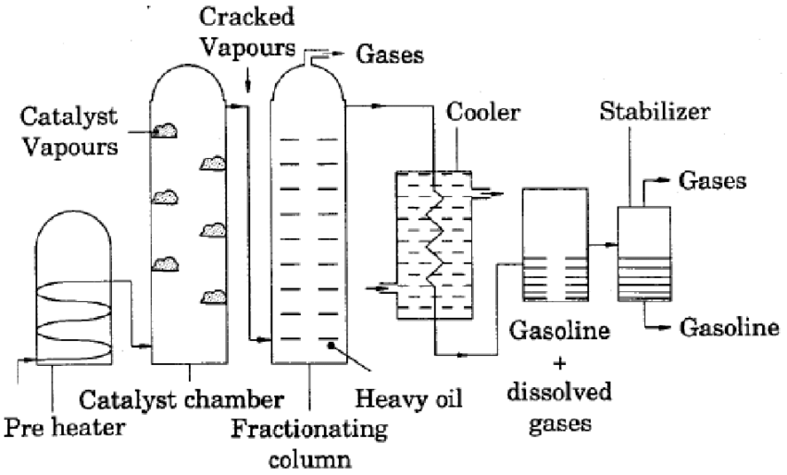
Major role play Chemists , Chemical and mechanical engineers
Catalytic cracking are two types
Fixed bed catalytic cracking: The oil vapours are heated in a pre-heater at cracking temperature (429-450 ºC) and then forced through catalytic chamber (artificial clay mixed with zirconium oxide and temperature as (429-450 ºC) and 1.5 kg/cm2 pressure.
Diagram for fixed bed catalytic cracking

Slide 18
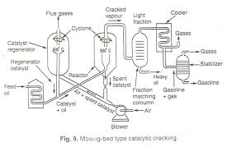
(ii) Fluidized moving bed catalytic cracking:
The solid catalysts are finely powdered, so that it behaves almost as a fluid, which can be mixed with gas phase of HCs.
The vapour of HCs mixed with fluidized catalyst is forced up into a large reactor ‘bed’ in which cracking of heavy oils into
Lighter molecules occurs. The neat diagram of this process is as follows.
Home work: (a) Explain the role of different
Units of this total diagram and machinery parts
for better yield from the diagram.
(b) What are the advantage and disadvantages
between the above two mentioned methods?
© what are the advantages and disadvantages
Between thermal and catalytic cracking?
Reference Book:
(i) Engineering chemistry Jain and Jain;
Dhanpat Rai publishing company
(ii) Petroleum Engineering of any reputed
publisher
Neat Diagram of Fluidized moving bed catalytic cracking

Slide 19
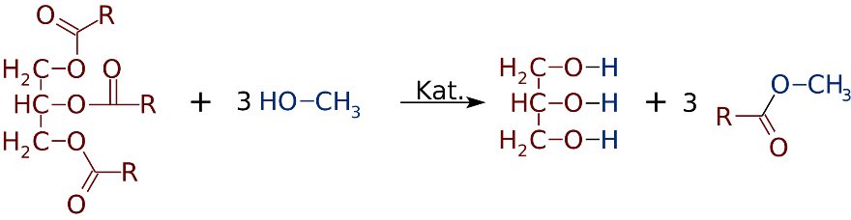
Biodiesel
Biofuels
Other forms of biofuels
First, second, third & fourth generation
Chemically edible oils are triacyl glycerol & are obtained from plants
They are trans-esterifed into Fatty Acid Methyl Ester (FAME)
FAME is used as biodiesel
Other fatty acid containing molecules may be used as source of biodiesel
100% biodiesel cannot be used with present vehicle engines
B-2, B-5 are used as present; target is B-20 to B-30

Slide 20
Poster
Petroleum is a non-renewable resource that took millions of years to form.
Our use of it has been unsustainable

Slide 21
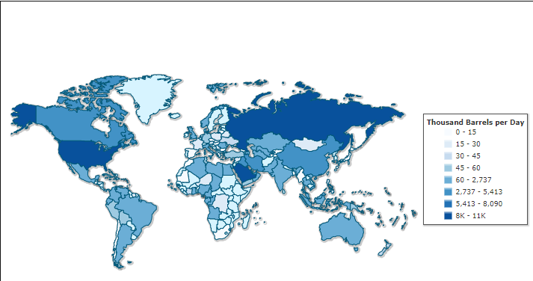
Out of syllabus: For your interest and information
Crude oil production map in the world per day

Slide 22
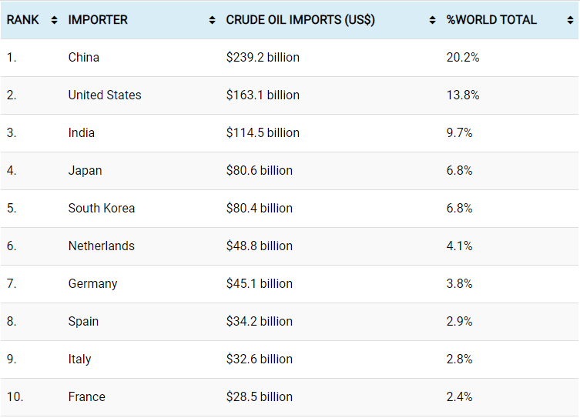

Slide 23
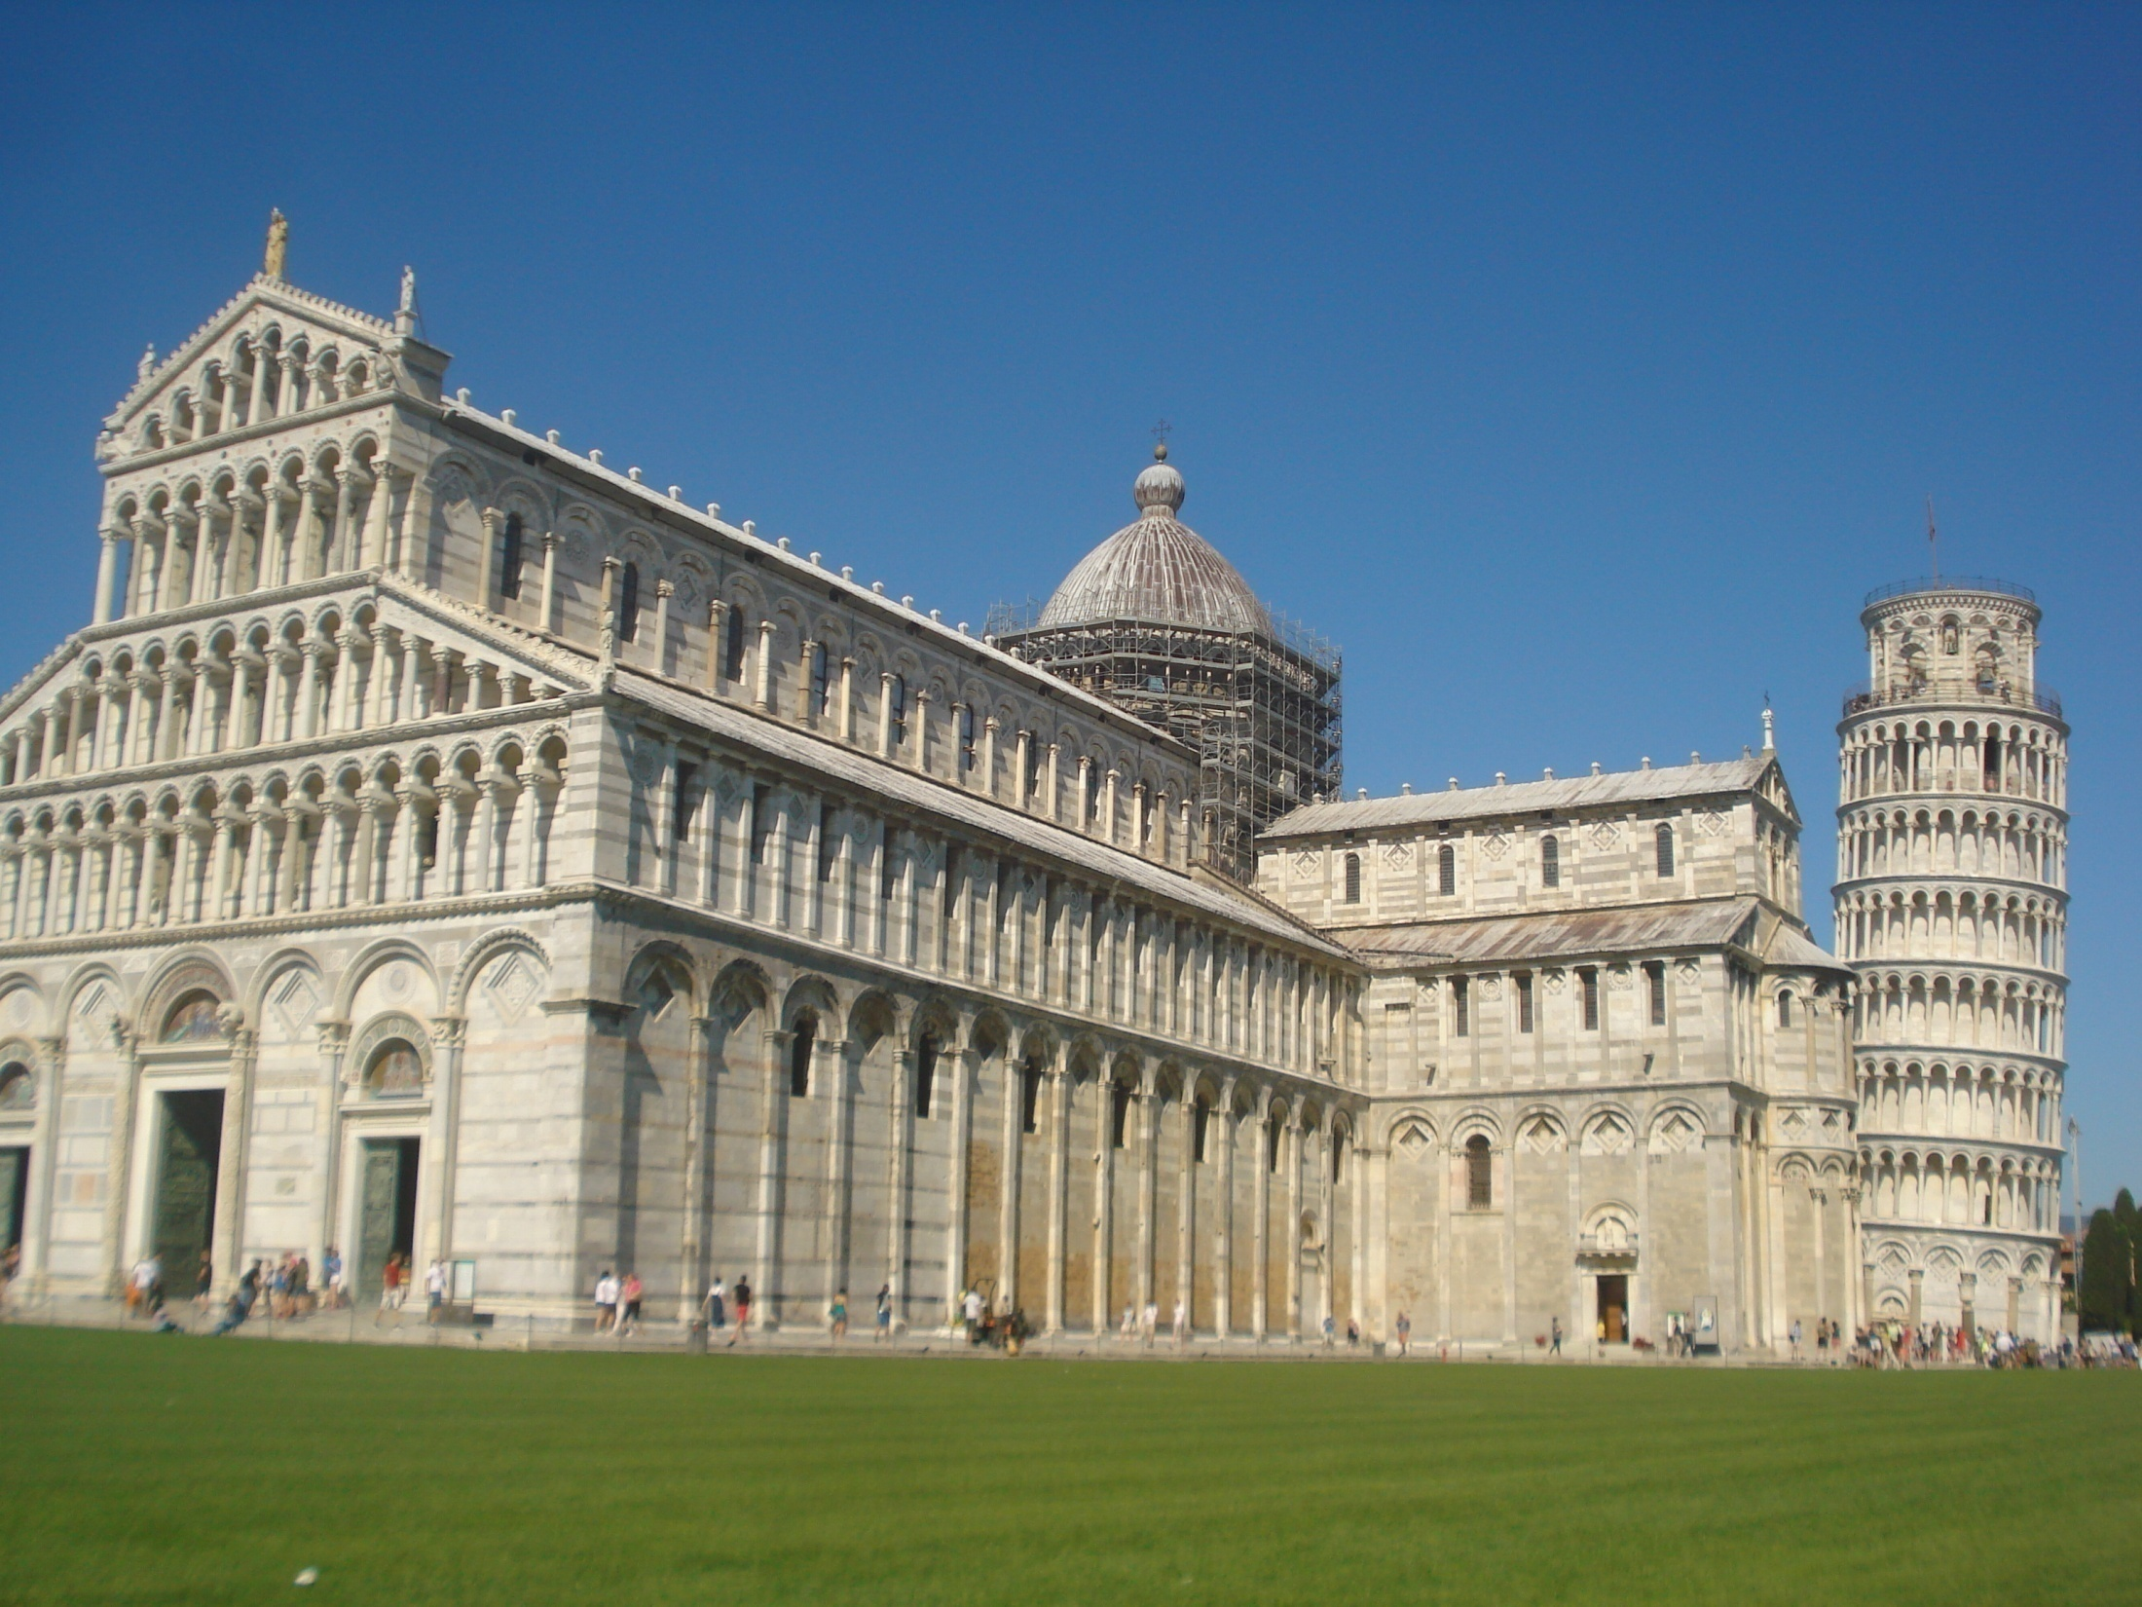
Thank you,
With best wishes!
Next PPT on Polymer Chemistry
and Engineering is coming soon.
N. B.: For any doubt, constructive criticism and suggestions or any correction to improve the power point would be most welcome. PPT is prepared within short time for the interest of B. Tech. students.
Own hand photography of Pisa tower, Italy: SCM

